Slide 1


Slide 2
Writing Strategies and Ethical Considerations
Chapter 4

Slide 3
Introduction
Have an idea of the general structure of topics
Structure depends on the design
Be aware of good writing practices
Anticipate ethical issues prior to the study

Slide 4
Writing the Proposal
Arguments presented in a proposal:
Consider early on in planning the study
  The major points that need to be addressed
  How they will convey a cohesive picture of the study
  What the core arguments to advance are

Slide 5
Writing the Proposal
Arguments presented in a proposal:
What do readers need to better understand the topic?
What do readers need to know about the topic?
What do you propose to study?
What is the setting, and who are the people you will study?
What methods do you plan to use to collect data?

Slide 6
Writing the Proposal
Arguments presented in a proposal:
How will you analyze the data?
How will you validate the findings?
What ethical issues will your study present?
What do preliminary results show about the practicability and value of the proposed study?

Slide 7
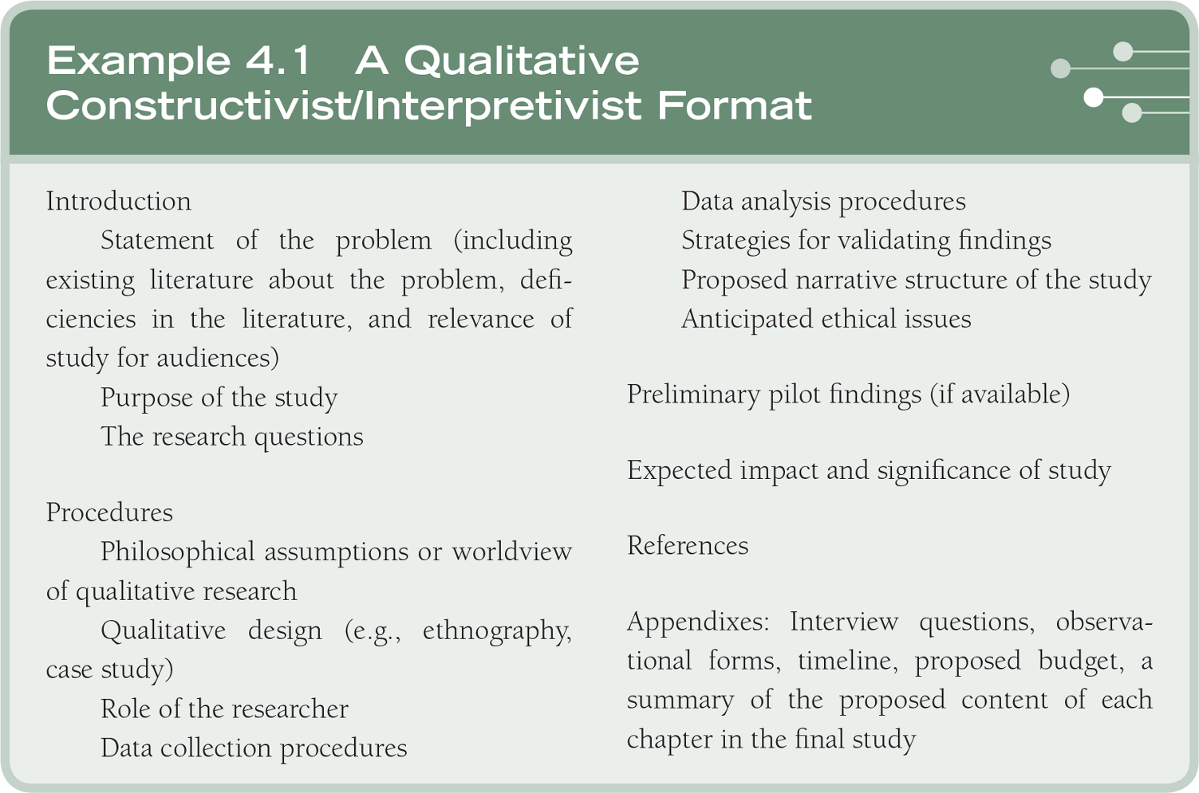
Writing the Proposal

Slide 8
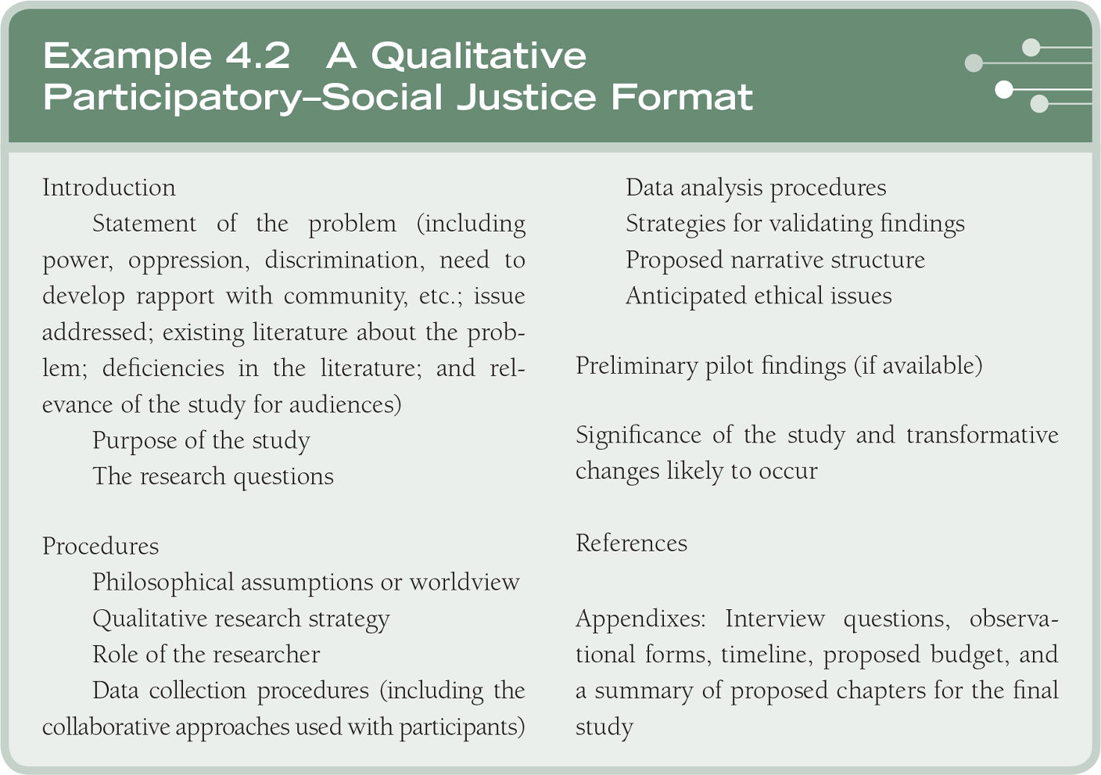
Writing the Proposal

Slide 9
Writing the Proposal
Format for a quantitative proposal:
Follow the format of a journal article
  Introduction
  A literature review
  Methods
  Results
  Discussion

Slide 10
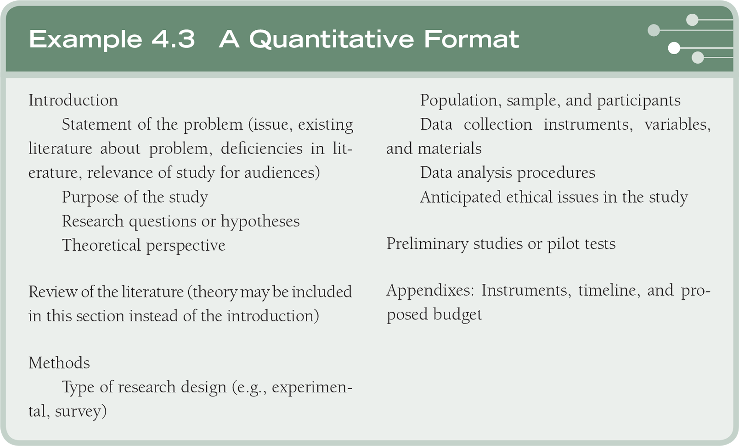
Writing the Proposal

Slide 11
Writing the Proposal
Format for a mixed methods proposal:
Purpose statement/research question for quantitative and qualitative components
Include mixed methods
  Rationale
  Design elements
  Visual diagram of procedures

Slide 12
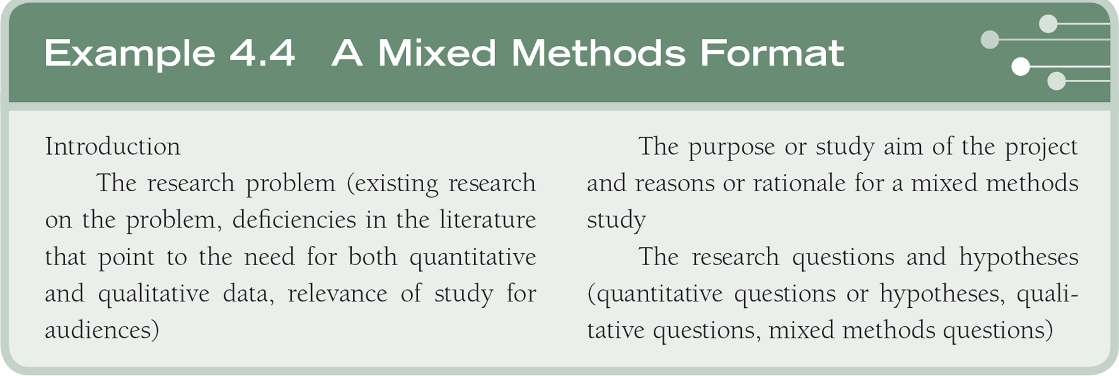
Writing the Proposal

Slide 13
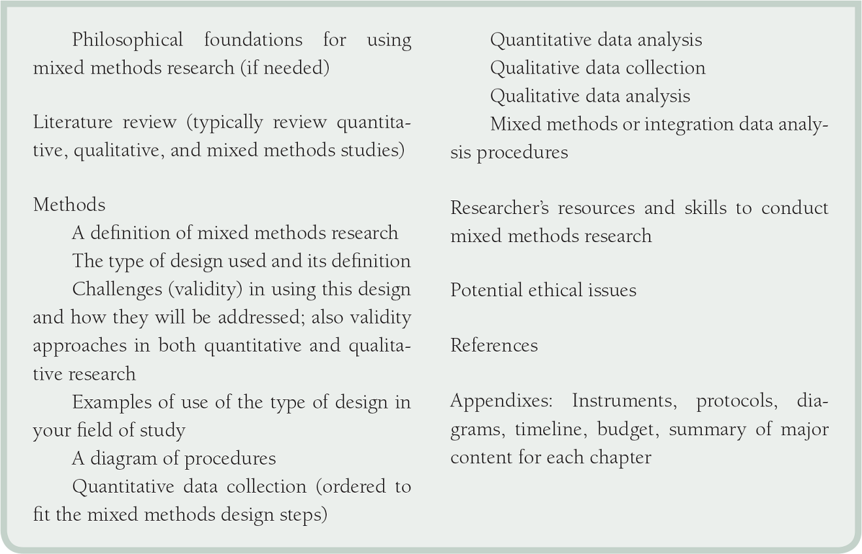
Writing the Proposal

Slide 14
Writing the Proposal
Designing the sections of a proposal:
Specify the sections early in the design of a proposal
Examine proposals that other students have authored under your advisor
Look for a course on proposal development
Review formats with your adviser

Slide 15
Writing Ideas
Read fiction and nonfiction widely
Read good literature
Always think about how the ideas writers share in their works might be applied in writing good research

Slide 16
Writing Ideas
Writing as thinking:
Write ideas down early in the process rather than talking about them
Work through several drafts of a proposal rather than trying to polish the first draft
Do not edit at the early draft stage
  Start with an outline
  Write a draft and shift and sort ideas
  Finally, edit and polish each sentence

Slide 17
Writing Ideas
The habit of writing:
Make writing a daily activity
Keep a daily chart of activities if you do not feel you have time to write
Write when fresh
Avoid binges
Write in small, regular amounts

Slide 18
Writing Ideas
The habit of writing:
Schedule writing tasks
Keep daily charts: time spent, page equivalents, percent complete
Plan beyond daily goals
Share your writing with supportive, constructive peers before going public
Try to work on two or three writing projects concurrently so that you do not become overloaded with any one

Slide 19
Writing Ideas
The habit of writing:
Exercises to improve writing
  Describe an object by its parts and dimensions
  Write a conversation between two people
  Write a set of directions for a complicated task
  Take a subject and write about it three different ways
  Choose a physical location for writing that is not a distraction

Slide 20
Writing Ideas
Readability of the manuscript:
Use consistent terms throughout the proposal
Consider how different type of narrative thought guide the reader:
  Umbrella thoughts – general or core ideas
  Big thoughts in writing – specific ideas
  Little thoughts – reinforcing big thoughts
  Attention or interest thoughts – keep the reader on track, organize ideas
Coherence in writing – ideas tie and logically flow

Slide 21
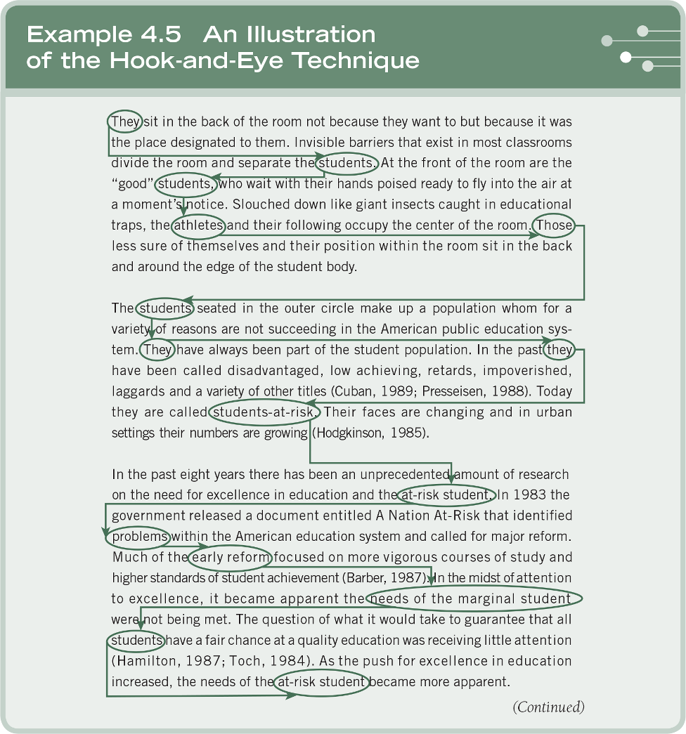
Writing Ideas

Slide 22
Writing Ideas
Voice, tense, and “fat”:
Eliminate unnecessary words
Delete the passive voice
Scale down qualifiers, eliminate overused phrases
Reduce excessive quotations, italics, and parenthetical comments

Slide 23
Writing Ideas
Voice, tense, and “fat”:
Use active voice
  “If the subject acts, the voice is active. If the subject is acted on, the voice is passive” (Ross-Larson, 1982, p. 29)
Use strong active verbs
Pay close attention to the tense of your verbs
Edit and revise drafts of a manuscript to trim fat
Write, review, edit

Slide 24
Ethical Issues to Anticipate
Research involves collecting data from people
Researchers need to
  Protect research participants
  Develop trust with research participants
  Promote the integrity of research
  Guard against misconduct
  Cope with new problems that emerge

Slide 25
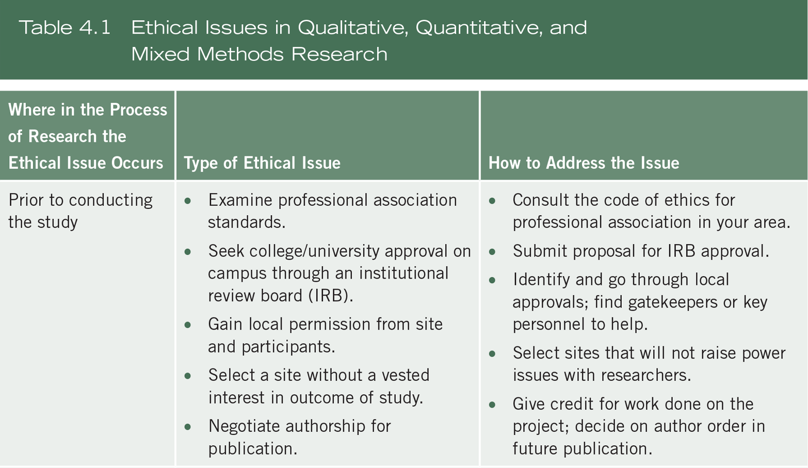
Ethical Issues to Anticipate

Slide 26
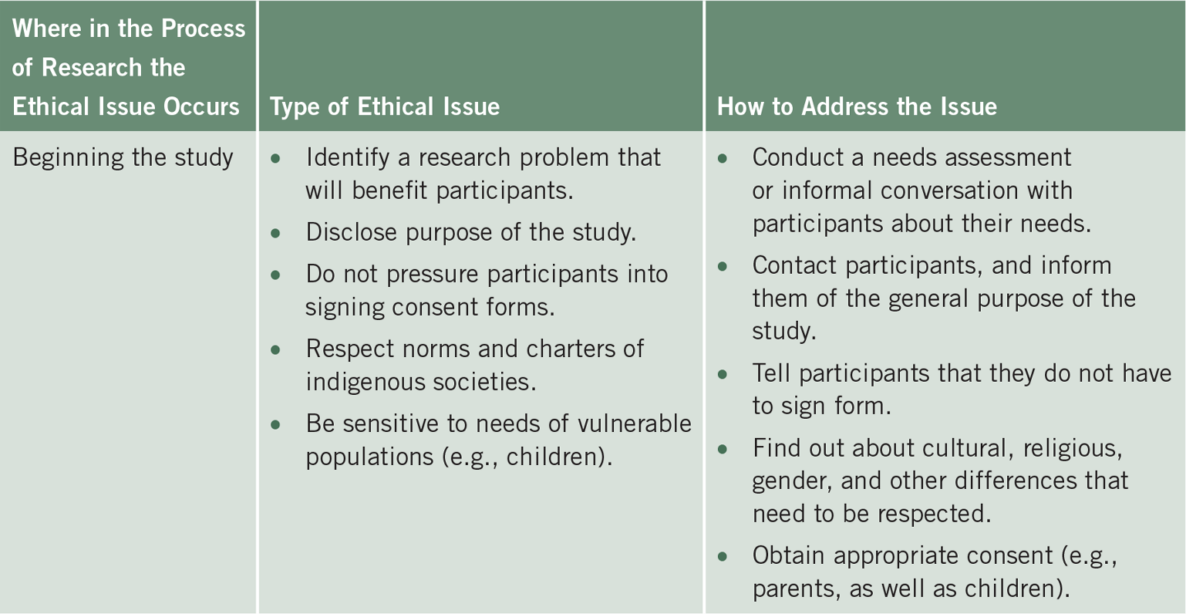
Ethical Issues to Anticipate

Slide 27
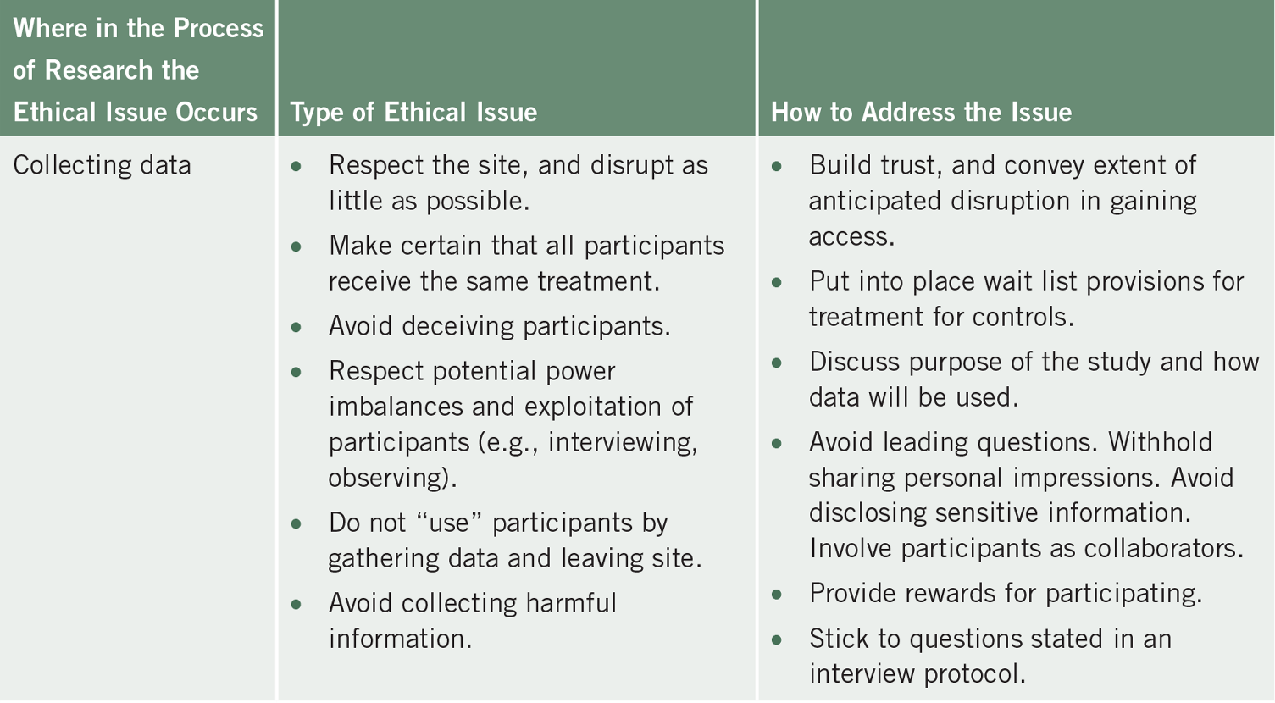
Ethical Issues to Anticipate

Slide 28
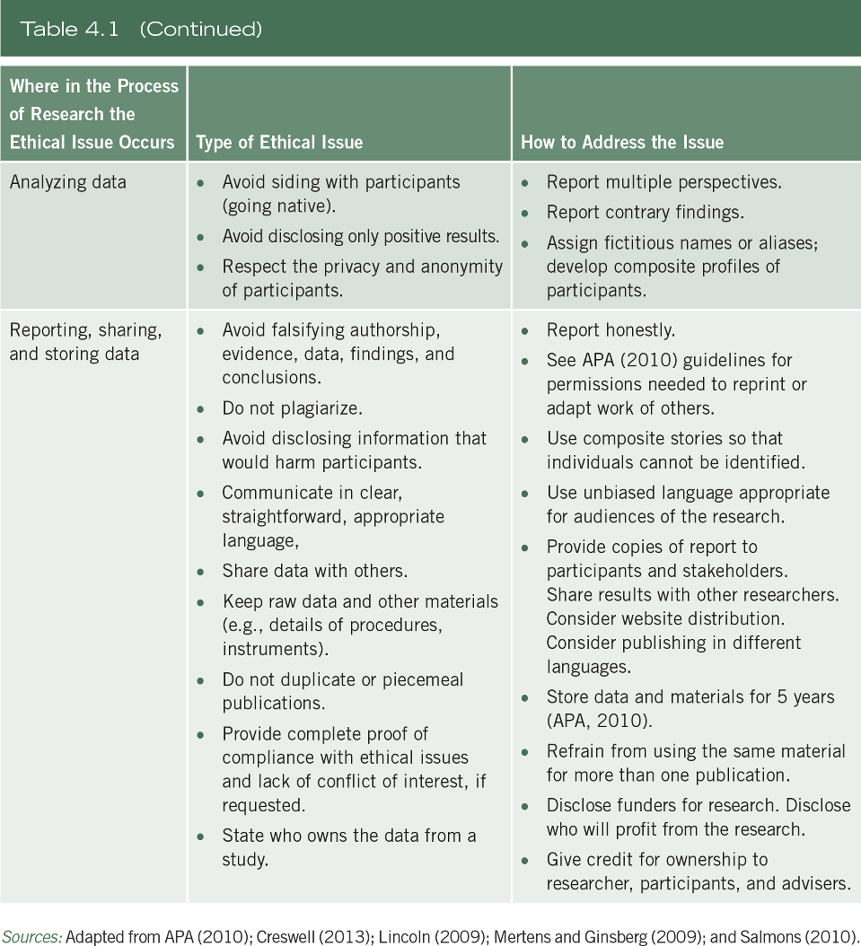
Ethical Issues to Anticipate

Slide 29
Ethical Issues to Anticipate
Prior to beginning the study:
Consider codes of ethics
Apply to the institutional review board
Obtain the necessary permissions to gain access to the site and to study participants
Select a site without vested interests
Negotiate authorship for publication

Slide 30
Ethical Issues to Anticipate
Beginning the study:
In the research problem:
  Identify a problem that will benefit individuals being studied
In the purpose and questions:
  Convey the purpose and sponsors of the research to participants
Do not pressure participants into signing consent forms, obtain informed consent from participants
Respect norms and charters of indigenous cultures

Slide 31
Ethical Issues to Anticipate
Collecting the data:
Respect the site, and disrupt as little as possible
Make sure all participants receive the benefits
Avoid deceiving participants
Respect potential power imbalances, consider reciprocity
Avoid exploitation of participants
Avoid collecting harmful information

Slide 32
Ethical Issues to Anticipate
Analyzing the data:
Avoid going native – taking sides or disregarding data
Avoid disclosing only positive results – reflect the statistical tests and diversity of perspectives

Slide 33
Ethical Issues to Anticipate
Analyzing the data:
Respect the privacy of participants:
  Protect anonymity of participants
  Remove names from responses
  Qualitative researchers use aliases and pseudonyms

Slide 34
Ethical Issues to Anticipate
Reporting, sharing, and storing data:
Do not falsify authorship, evidence, data, findings or conclusions
Do not plagiarize
Avoid disclosing information that would harm participants
Communicate in clear straightforward, appropriate language

Slide 35
Ethical Issues to Anticipate
Reporting, sharing, and storing data:
Share data with others (e.g. stakeholders, participants)
Keep raw data and other materials for a reasonable period of time
Do not duplicate or piecemeal publications
Complete proof of compliance with ethical issues and lack of conflict of interest
Understand who owns the data

Slide 36
Summary
How to write a proposal
Use one of the outlines for a qualitative, quantitative, or mixed methods proposal
Importance of putting words on paper
Consider anticipated ethical issues and describe

